Slide 1



X
Data Warehouse and ETL Implementation
ID/X Partners – Data Engineer
Presented by
Rahmat Satyawan

Slide 2

Disclaimer
Kalian dapat mengganti design template ini sesuai kreativitas kalian.
Template ini hanya bertujuan untuk memberikan gambaran isi konten yang wajib dibuat oleh peserta.

Slide 3



Education and Experience
Education
STTN BATAN 2014-2018
Electronics Instrumentation – Nuclear Technophysics GPA 3.63/4.00
Rahmat Satyawan
Experience
2+ in Nuclear industry as NDT Inspector, Engineer and Radiation Safety Officer, Currently switching to Data and Web industry
Bit.ly/rahmatst

Slide 4
Case Study
One of the clients of ID/X Partners, operating in the e-commerce sector, has a need to create a Data Warehouse sourced from several tables in the source database. This Data Warehouse will consist of one Fact table and several Dimension tables.

Slide 5
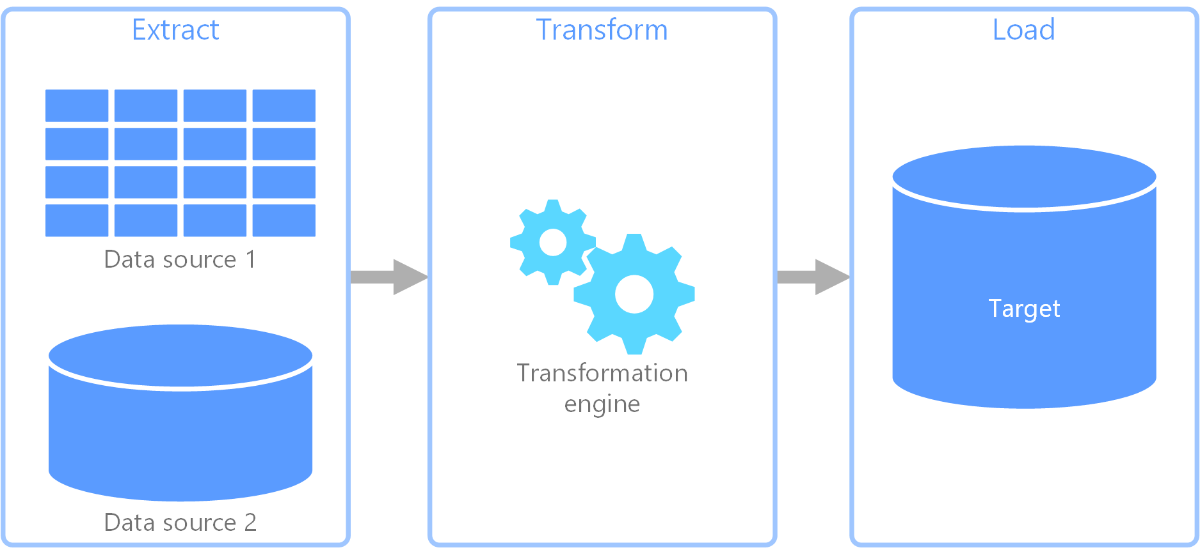
Case Study
Restore Database Staging.bak
SQL Server + SSMS
ETL
Concat Column
Rename Column
Talend Open Studio
Target Database
DWH_Project
Talend Open Studio + SSMS

Slide 6
Prerequisite
Microsoft SQL Server (Link Here)
SSMS SQL Server Management Studio (Link Here)
Talend Open Studio for Data Integration (Link Here)
Database Staging (Link Here)

Slide 7
Process
Import/Restore Database Staging.bak ke SQL Server + SSMS
Create New Database DWH_Project with table and attribute as the rule of challenge
Create project job ETL in Talend Open Studio from Staging.bak to target DWH_Project with detail Transformation
Create Store Procedure to show summary sales order base on status order in SSMS from DWH_Project Database that already processed from ETL

Slide 8
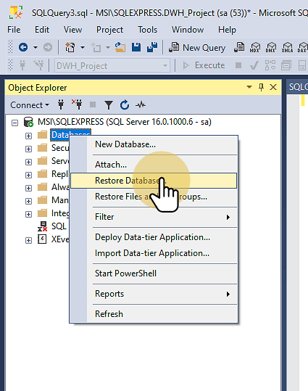
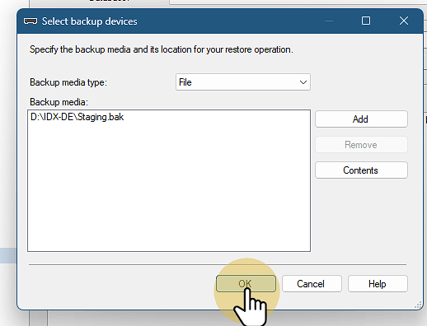
Process
Import/Restore Database Staging.bak ke SQL Server + SSMS
Right click on Database > Restore Database
Click Device and select Staging.bak file in computer
Click OK then if success will be notify Database restored successfully

Slide 9
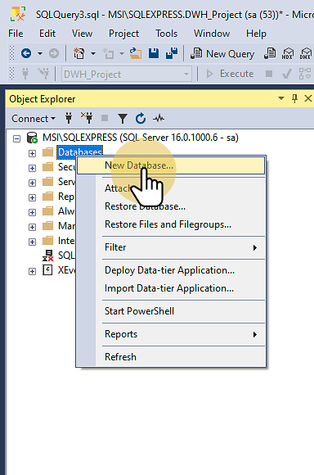
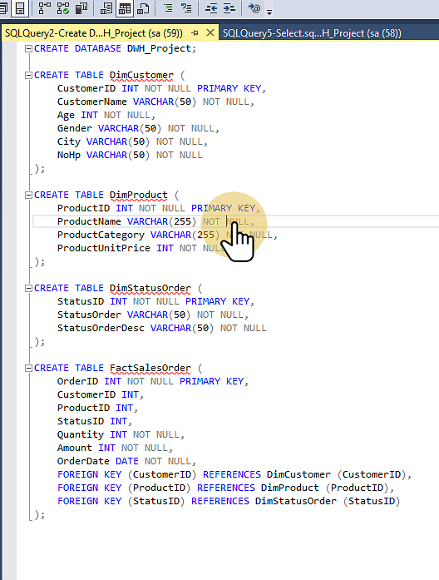
Process
2. Create New Database DWH_Project with table and attribute as the rule of challenge
Right click on Database > New Database
Insert Database Name with DWH_Project , then click OK
Right click on Database DWH_Project > New Query to add table and column Or you can make new database with query CREATE DATABASE in SSMS

Slide 10
Process
3. Create project job ETL in Talend Open Studio from Staging.bak to target DWH_Project with detail Transformation
Import Database Staging as Input and Database DWH_Project as Output
Create job per table (Customer, Product, Sales Order, Sales Status)
Create job with
- Input > DBInput Staging
- Transform > tMaps
- Output > DBOutput DWH_project
And Run all Job and see the result in SSMS with SELECT Query

Slide 11
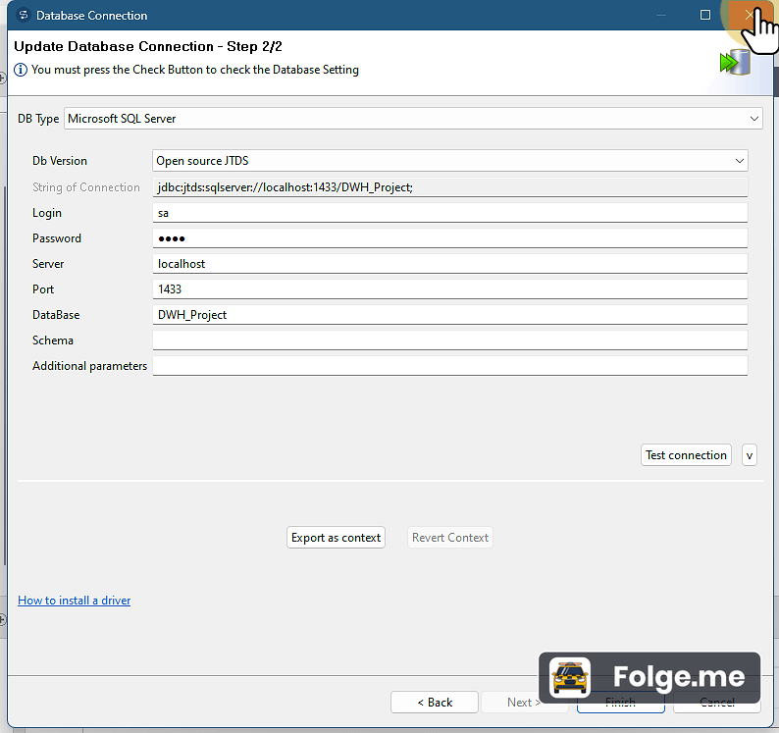
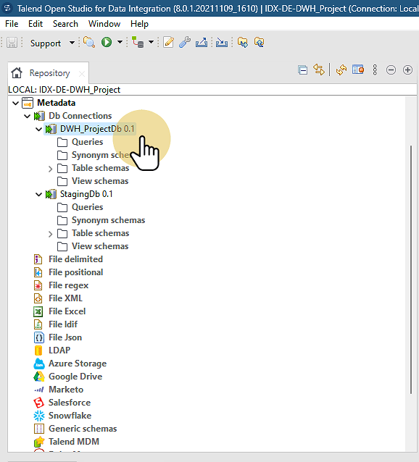
Process
3. Create project job ETL in Talend Open Studio from Staging.bak to target DWH_Project with detail Transformation
Import Database Staging as Input and Database DWH_Project as Output

Slide 12
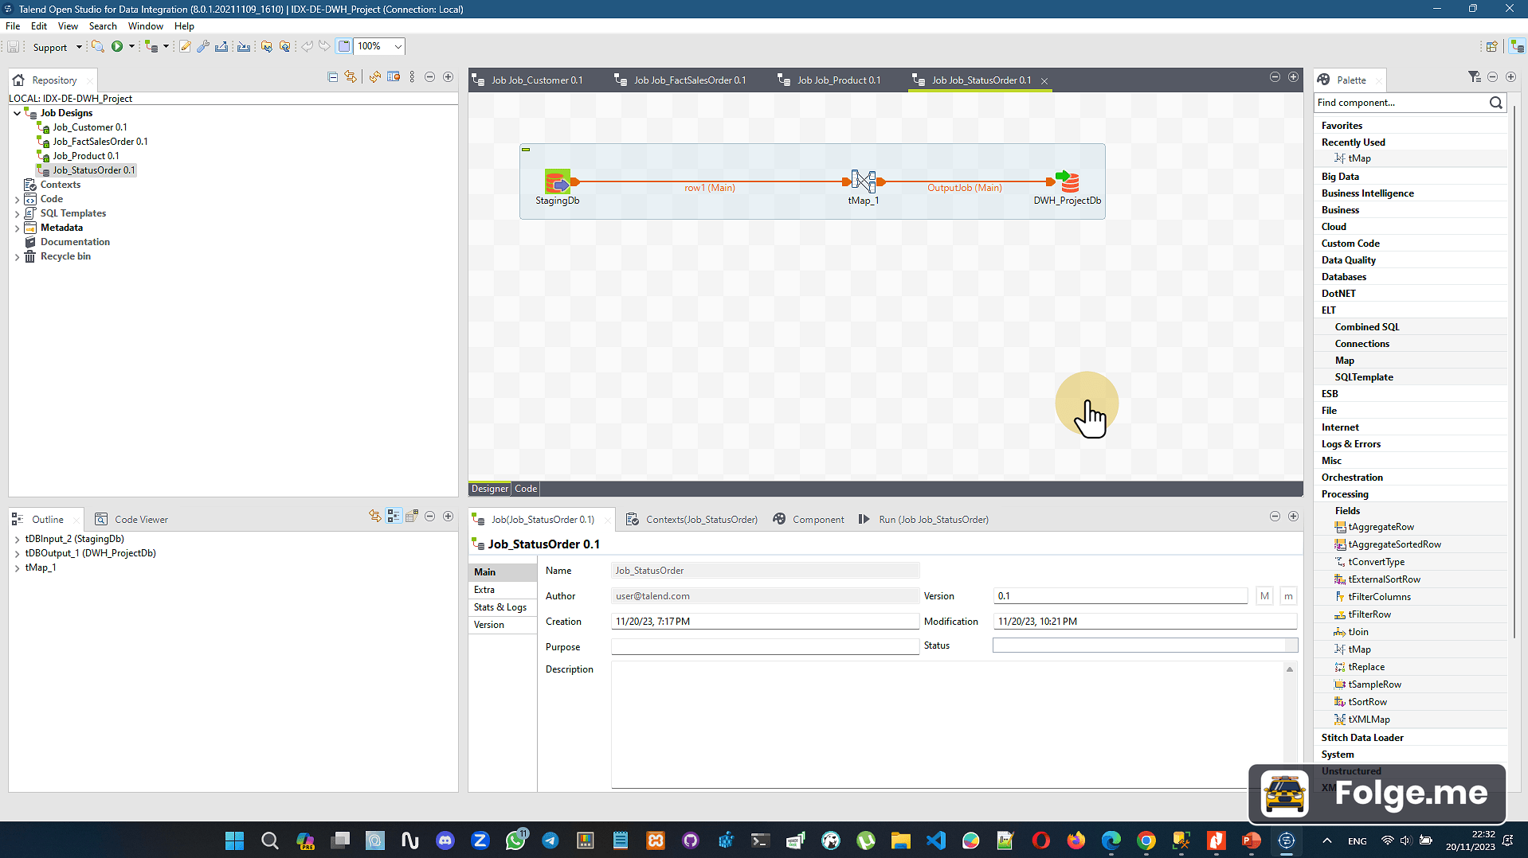
Process
3. Create project job ETL in Talend Open Studio from Staging.bak to target DWH_Project with detail Transformation
2. Create job per table (Customer, Product, Sales Order, Sales Status)

Slide 13
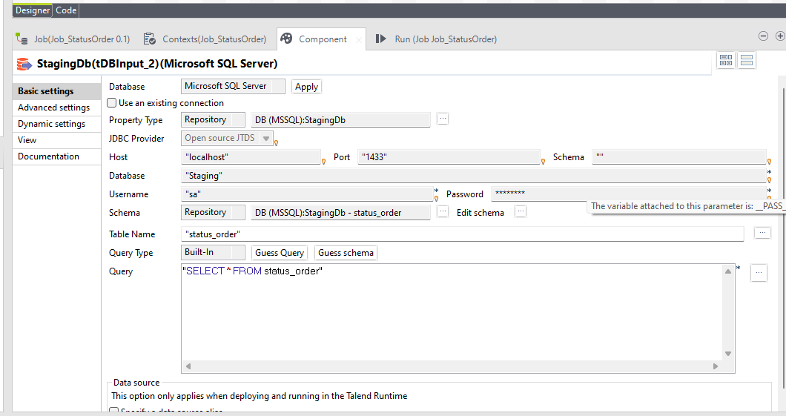
Process
3. Create project job ETL in Talend Open Studio from Staging.bak to target DWH_Project with detail Transformation
Create job ( Input > DBInput Staging, Transform > tMaps Output > DBOutput DWH_project )
For Input Configuration Ex. Table Status Order

Slide 14
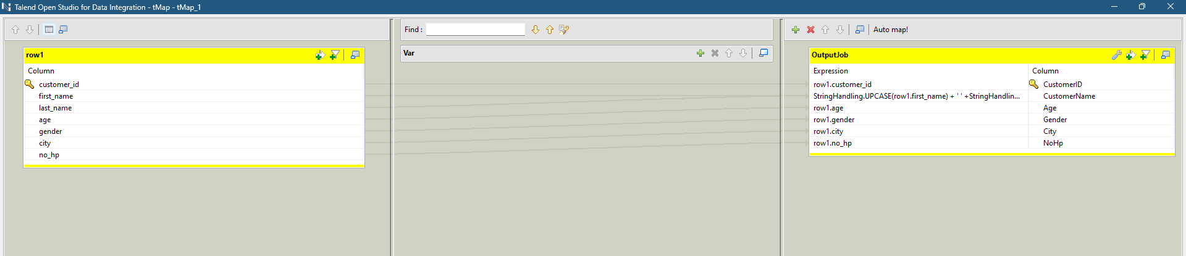
Process
3. Create project job ETL in Talend Open Studio from Staging.bak to target DWH_Project with detail Transformation
Create job ( Input > DBInput Staging, Transform > tMaps Output > DBOutput DWH_project )
For tMaps Configuration Ex. Table Customer

Slide 15
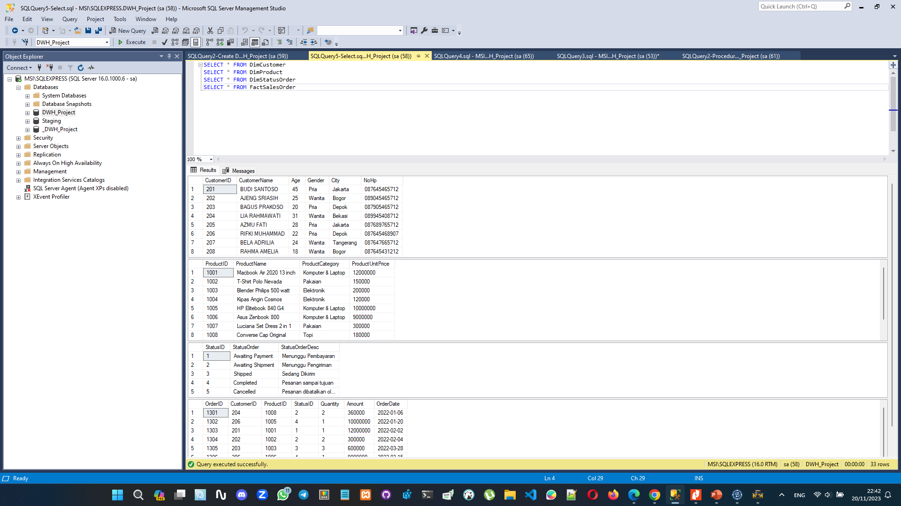
Process
3. Create project job ETL in Talend Open Studio from Staging.bak to target DWH_Project with detail Transformation
Result in SSMS

Slide 16
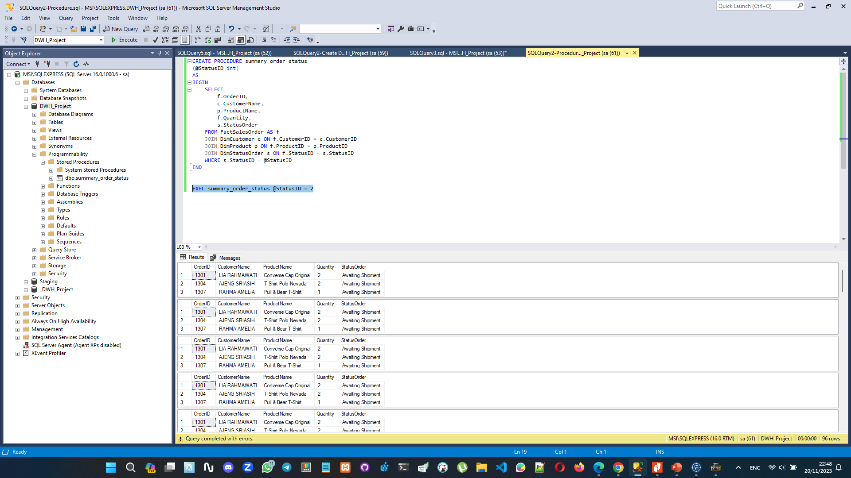
Process
4. Create Store Procedure to show summary sales order base on status order in SSMS from DWH_Project Database that already done in ETL
Right click on Database DWH_Project > New Query
Write the Store Procedure as it is
Run the SP with EXEC summary_order_status @StatusID = 2
The result will be shown in table below the query

Slide 17
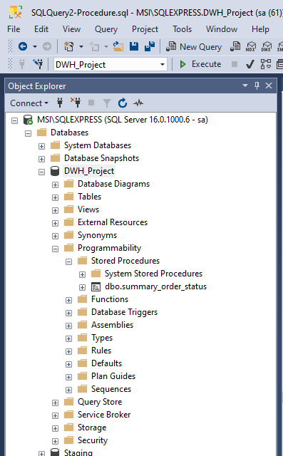
Process
4. Create Store Procedure to show summary sales order base on status order in SSMS from DWH_Project Database that already done in ETL
You can see the Store Procedure will be saved in Database > Programmability > Stored Procedures > Your SP in this case dbo.summary_order_status

Slide 18
Result
New Database DWH_Project (Backup with SSMS DWH_Project.bak) as result the ETL from staging.bak
The Pipeline Process ETL for Staging.bak Database with Talend include function input, tMaps, and output database SQL Server
Stored Procedure dbo.summary_order_status to know the summay from order status

Slide 19
Result
Link Video Presentation (Link Here)
Link Github (Link Here)

Slide 20
Thank You
X

